Slide 1
Design Data Implementations

Slide 2
Exam 70-535 : Architecting Microsoft Azure Solutions
Design Data Implementation (15 – 20%)
Design for Azure Storage solutions
Determine when to use Azure Blob Storage, blob tiers, Azure Files, disks, and StorSimple
Design for Azure Data Services
Determine when to use Data Catalog, Azure Data Factory, SQL Data Warehouse, Azure Data Lake Analytics, Azure Analysis Services, and Azure HDInsight
Design for relational database storage
Determine when to use Azure SQL Database and SQL Server Stretch Database; design for scalability and features; determine when to use Azure Database for MySQL and Azure Database for PostgreSQL; design for HA/DR, geo-replication; design a backup and recovery strategy
Design for NoSQL storage
Determine when to use Azure Redis Cache, Azure Table Storage, Azure Data Lake, Azure Search, Time Series Insights
Design for CosmosDB storage
Determine when to use MongoDB API, DocumentDB API, Graph API, Azure Tables API; design for cost, performance, data consistency, availability, and business continuity

Slide 3
Agenda
Overview
Azure Storage Services
Azure Data Services
Q&A
Resources

Slide 4
































































Azure Service Map
Platform Services
Security & Management
Hybrid
Cloud
Media & CDN
Application Platform
Data
Security Center
Media Services
Media Analytics
Content Delivery
Network
SQL
Database
SQL Data
Warehouse
Azure AD
Health Monitoring
Web
Apps
Mobile
Apps
DocumentDB
Portal
AD Privileged
Identity
Management
Azure Active
Directory
Integration
API
Apps
Cloud
Services
SQL Server
Stretch Database
Redis
Cache
Storage
Tables
Azure
Search
Azure AD
B2C
API
Management
BizTalk
Services
Intelligence
Domain Services
Service
Fabric
Notification
Hubs
Multi-Factor
Authentication
Logic
Apps
Service Bus
Functions
Cognitive Services
Bot Framework
Cortana
Backup
Automation
Developer Services
Analytics & IoT
Operational
Analytics
Compute Services
Scheduler
Mobile
Engagement
HDInsight
Machine
Learning
Stream Analytics
Container
Service
VM
Scale Sets
Visual Studio
Import/Export
Key Vault
Data
Catalog
Data Lake
Analytics Service
Data Lake Store
Store/
Marketplace
Batch
RemoteApp
VS Team Services
Xamarin
Azure Site
Recovery
Application
Insights
HockeyApp
IoT Hub
Event
Hubs
Data
Factory
Power BI
Embedded
VM Image Gallery
& VM Depot
Dev/Test Lab
StorSimple
Infrastructure Services
Compute
Storage
Networking
Virtual Machines
Containers
Blob
Queues
Files
Disks
Virtual Network
Load Balancer
DNS
Express
Route
Traffic Manager
VPN Gateway
App
Gateway
Datacenter Infrastructure (32 Regions, 24 Online)
Notes:
Why this Slide:
It shows we have a very broad platform. It about BOTH IaaS and PaaS, that these work together. It shows that we continue to lead in world class IT capabilities and that there’s really nothing missing.
Key Points:
We have already seen how the Azure Platform is IaaS + Pass – but I want you to understand that this is a huge number of capabilities – IT building blocks if you will.
Every one of these blocks you provision anytime, self-service anywhere in the world 24x7. You pay for what you use, you can get more or less anytime and you can fully automate everything…
DON’T spent too much time on this slide – you are going to DEMO (aren’t you!!!)… DON’T go through each block…
Transition to NEXT Slide: Make the build go backwards to show JUST IaaS and then you will go to the demo to show it.

Slide 5
Azure Storage Services

Slide 6
Azure Storage Solutions
Azure Blobs: A massively scalable object store for text and binary data.
Azure Files: Managed file shares for cloud or on-premises deployments.
Azure Queues: A messaging store for reliable messaging between application components.
Azure Tables: A NoSQL store for schemaless storage of structured data.
Azure Disks: managed and unmanaged disk capabilities used by virtual machines.
Notes:
https://docs.microsoft.com/en-us/azure/storage/common/storage-introduction
https://docs.microsoft.com/en-us/azure/storage/
https://docs.microsoft.com/en-us/azure/virtual-machines/windows/premium-storage
https://docs.microsoft.com/en-us/azure/storage/files/storage-files-introduction
Blobs are basically files like those that you store on your computer
access them from anywhere in the world using URLs, the REST interface, or one of the Azure SDK storage client libraries. Storage client libraries are available for multiple languages, including Node.js, Java, PHP, Ruby, Python, and .NET.

Slide 7
Exam Tip
Know:
The various storage types their uses, how they are alike & how they are different. aka.ms/azure/storage

Slide 8
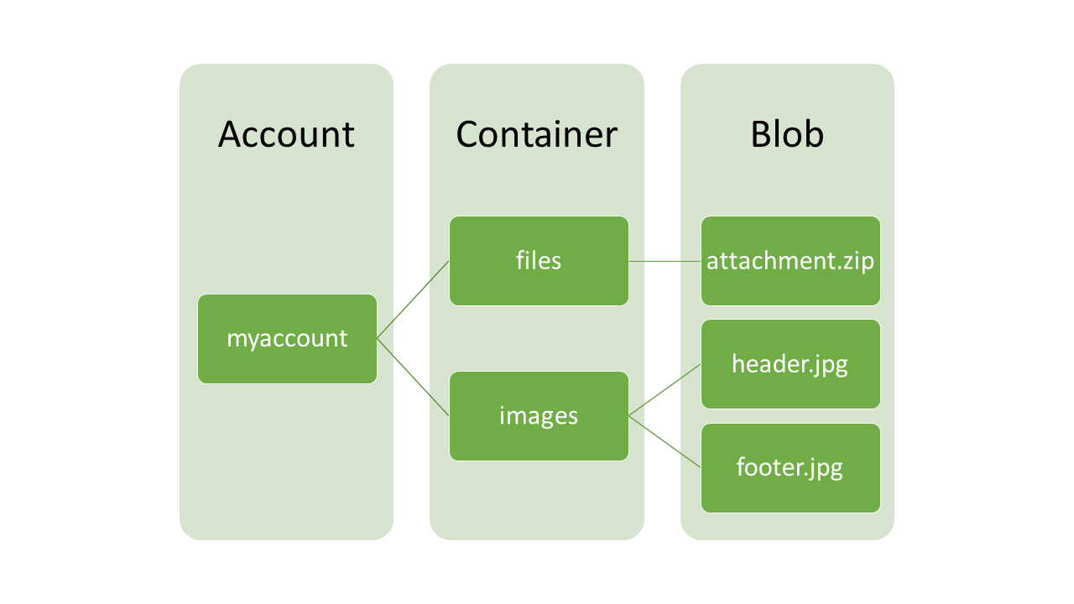
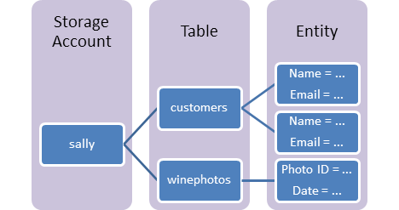
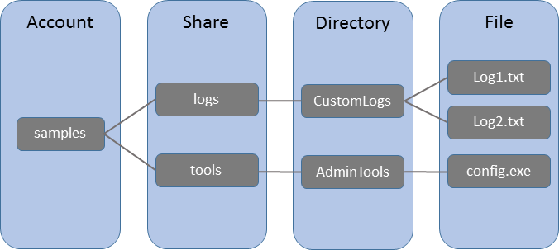
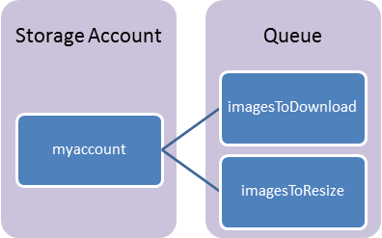
Azure Storage Account Schematic
Blob Storage
Azure Table
File Storage
Azure Queue

Slide 9
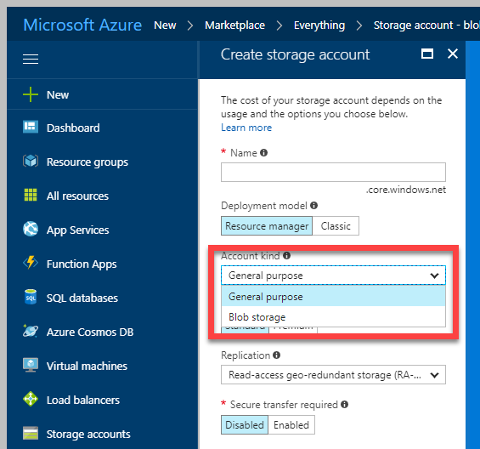
Azure Storage Account
Two Kinds of Storage Account
General Purpose Storage Account
Blobs
Files
Queues
Tables
VHD Disks(Page Blob)
Blob Storage Account
Block Blob
Append Blob
Page Blob

Slide 10
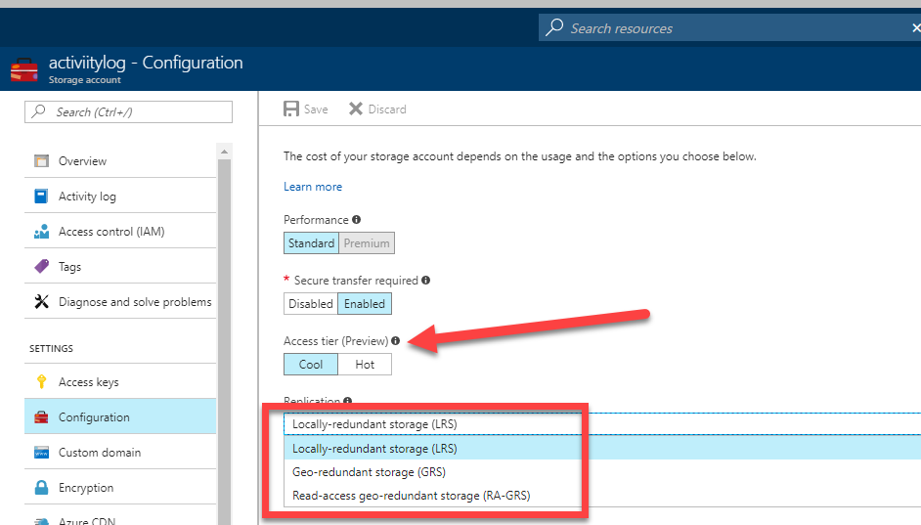
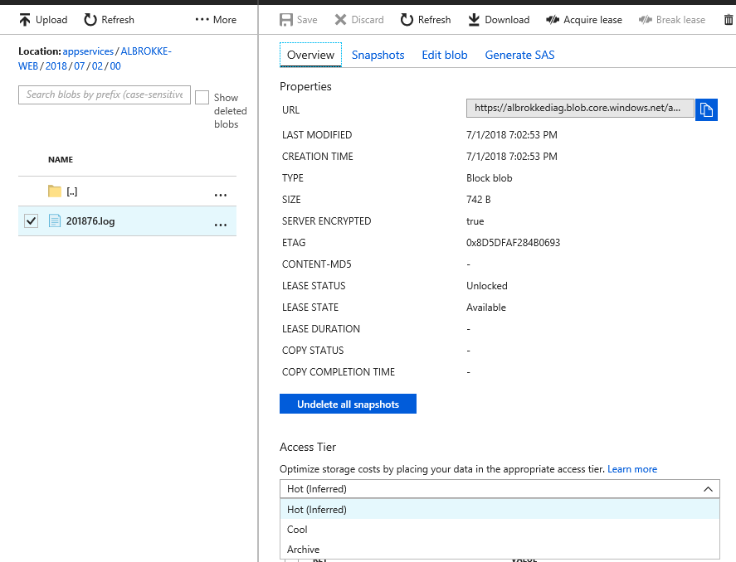
Storage Parameters
Performance
Standard(HDD based)
Premium(SSD based)
Access Tier
Hot,
Cool
Archive

Slide 11
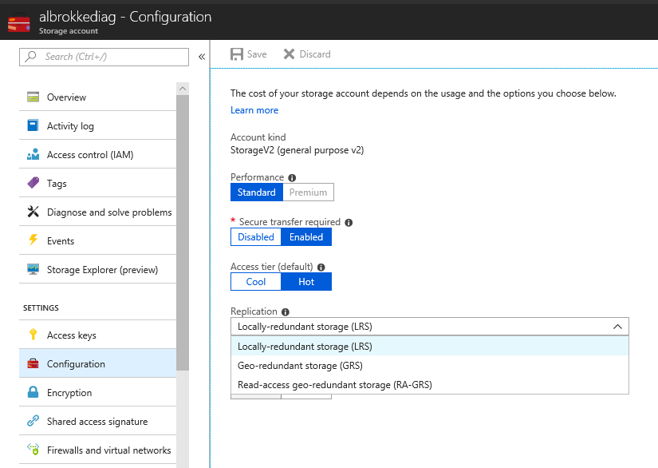
Storage Parameters
Replication
Locally Redundant Storage (LRS)
Zone Redundant Storage (ZRS)
Geo Redundant Storage (GRS)
Read Access Geo Redundant Strorage (RA-GRS)

Slide 12
Azure File Storage
Fully managed file shares in the cloud
Supports SMB /CIFS protocol
Can be mounted concurrently
Azure File Sync(Preview)
Suitable for Lift & Shift
LRS, GRS replication

Slide 13
Azure Table Storage
Stores NoSQL Data
Key-value pair
Structured, non relational
Schemaless
Access data using the Odata & LINQ
Quickly query data using a clustered index
Data is consistent for other client reads after insert/update

Slide 14
Azure Queue
Provides reliable, persistent messaging.
REST-based GET/PUT/PEEK
Maximum Message Size 64 KB. If larger message size needed use Service Bus
Maximum message TTL 7 days

Slide 15
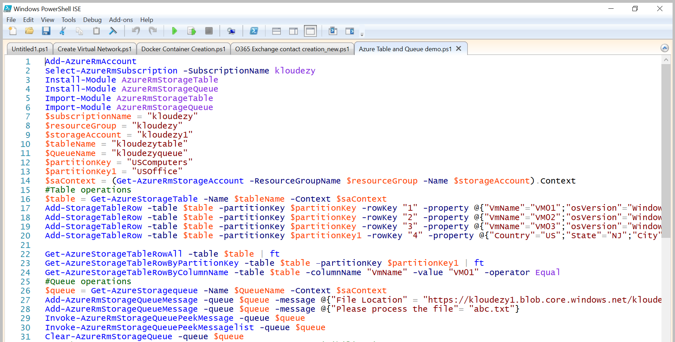
Table and Queue Storage via PowerShell

Slide 16
Storage Options
Standard
Max total request rate of 20k IOPS
Billed for actual usage*
Premium
Designed for Azure VMs
High performance
Low latency
Azure VM disks are implemented as “Page Blobs”
Billed for Provisioned space and not for actual usage.

Slide 17
Azure Blob Storage
Also called Object Storage
Storing large amounts of unstructured object data
Can be accessed from anywhere via HTTP or HTTPS
Three kinds of Blobs:
Block Blob
Append Blob
Page Blob
Common uses of Blob storage include:
Serving images or documents directly to a browser
Storing files for distributed access
Streaming video and audio
Storing data for backup and restore, disaster recovery, and archiving

Slide 18
Block Blobs
Blob is broken into pieces
Block Id for each piece
Max block size = 100MB
Up to 50k blocks per blob
The maximum size of a block blob is ~4.75 TB
Blocks upload can be multithreaded
Streaming , Storing documents, media files, backups

Slide 19
Append Blobs
Similar to Block Blobs
Optimized for append operations
Only can add to the end
The maximum size of an append blob is ~195 GB
Updating or deleting of existing blocks is not supported
Unlike a block blob, an append blob does not expose its block IDs.

Slide 20
Page Blob
Optimized for IaaS disks
Supports random read/writes
Collection of 512 byte pages
Max size = 8TB/4TB(VHD)
Storage Options
Premium Storage(SSD based)
Standard Storage(HDD based)

Slide 21
Blob Access
Anonymous Access: Public access for containers or individual blobs
Storage Access Key
Shared Access Signatures (SAS)
Delegated access without sharing account key
Containers & blobs
File shares & files
Queues
Tables & ranges of table entities

Slide 22
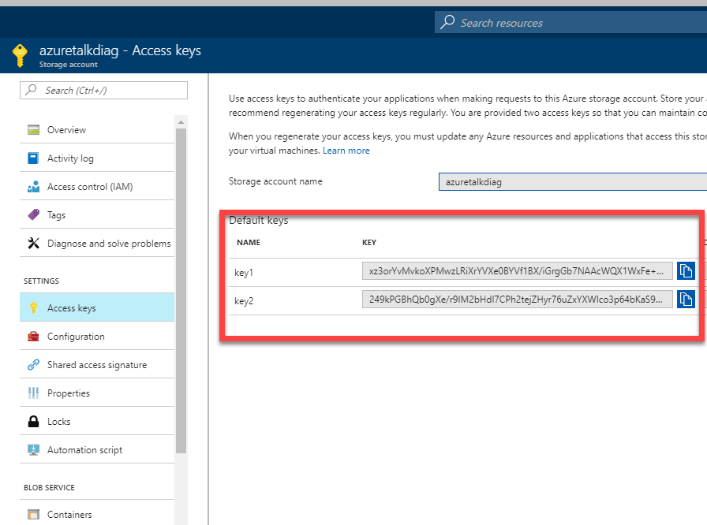
Blob Access

Slide 23
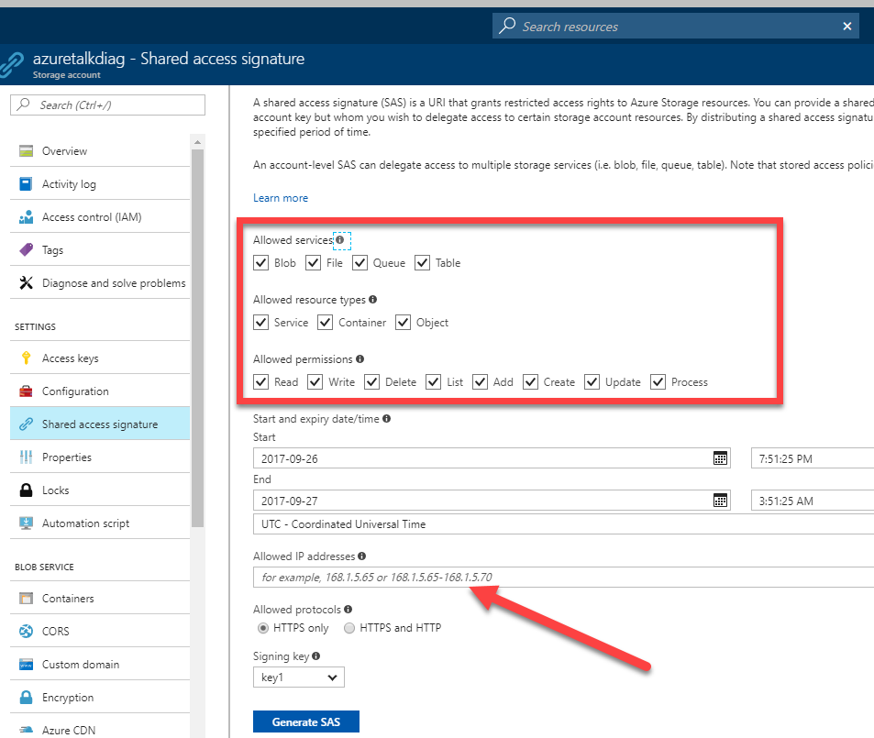
Shared Access Signatures (SAS)
Time interval
Start & end time for permissions
Permissions
Read, Write, and/or Delete
(Optional) IP address or address range
Allowed protocols
Example: only https

Slide 24
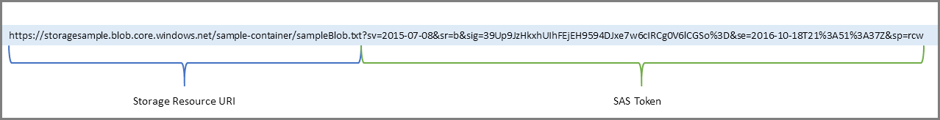
Exam Tip
Know:
How to access azure storage with Shared Access Signatures https://docs.microsoft.com/en-us/azure/storage/common/storage-dotnet-shared-access-signature-part-1
Practice:
Use Microsoft Azure Storage Explorer to work with Azure Storage data on Windows, macOS and Linux. http://storageexplorer.com/
Know:
The SAS Key Format

Slide 25
Azure Disk
Unmanaged Disk
In an unmanaged disk, you manage the storage accounts
VHDs are stored in Page blob
99.99% SLA.
Can be converted to Managed.
Managed Disk
Azure manages the storage accounts that you use for your VM disks
Available in Standard & premium tier.
Standard can be converted in to Premium and vice-versa
99.999% SLA
Recommended storage for VMs.
Allow you to create up to 10,000 VM disks in a subscription
Billing for managed disks depends on the provisioned size of the disk.
Managed disk Overview

Slide 26
Exam Tip
Know:
The storage account name should always in lowercase and unique within *.core.windows.net namespace.
Choose page blob uploading VHD. If VHD files are uploaded in block blob you can’t use those.

Slide 27
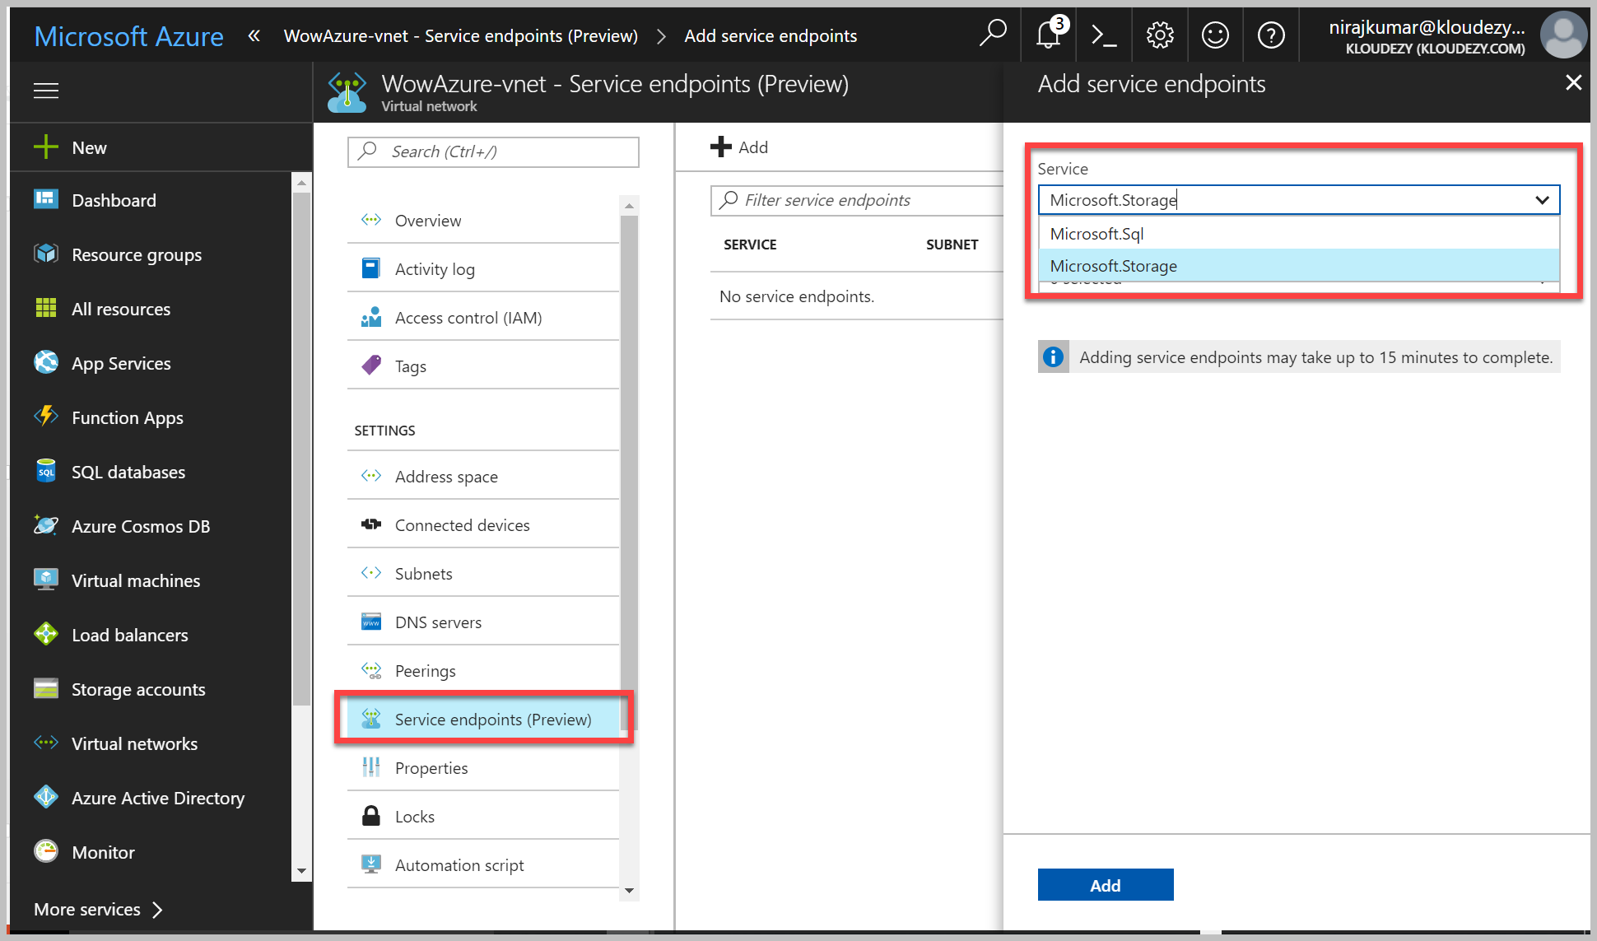
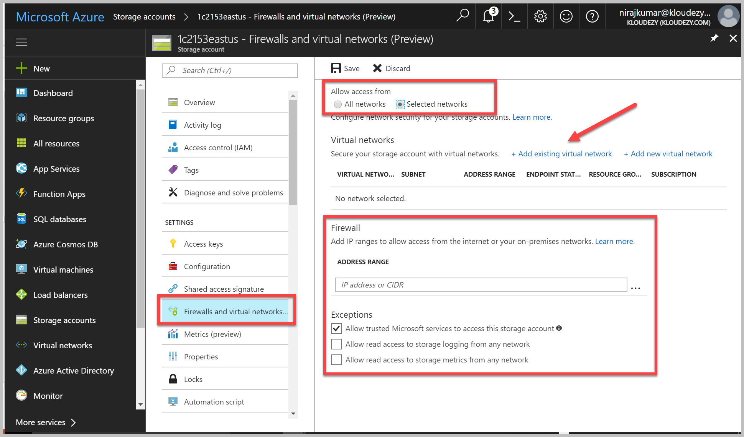
Blob Encryption/Security
Client-side
Storage Client Library for .NET
Server-side
“Data at Rest”
“Data in Transit”. Can be enforced.
Service Endpoints
Storage Firewall

Slide 28
Service Limits
https://docs.microsoft.com/en-us/azure/storage/storage-scalability-targets
Resource | Default Limit
Number of storage accounts per subscription | 200
TB per storage account | 500 TB
Max number of blob containers, blobs, file shares, tables, queues, entities, or messages per storage account | Only limit is the 500 TB storage account capacity
Max size of a single blob container, table, or queue | 500 TB
Max number of blocks in a block blob or append blob | 50,000
Max size of a block in a block blob | 100 MB
Max size of a block blob | 50,000 X 100 MB (approx. 4.75 TB)
Max size of a block in an append blob | 4 MB
Max size of an append blob | 50,000 X 4 MB (approx. 195 GB)
Max size of a page blob | 4 TB
Max size of a table entity | 1 MB

Slide 29
Service Limits
Resource | Default Limit
Maximum Request Rate per storage account | Blobs: 20,000 requests per second for blobs of any valid size (capped only by the account's ingress/egress limits)
 | Files: 1000 IOPS (8 KB in size) per file share
 | Queues: 20,000 messages per second (assuming 1 KB message size)
 | Tables: 20,000 transactions per second (assuming 1 KB entity size)
Target throughput for single blob | Up to 60 MB per second, or up to 500 requests per second
Target throughput for single queue (1 KB messages) | Up to 2000 messages per second
Target throughput for single table partition (1 KB entities) | Up to 2000 entities per second
Target throughput for single file share | Up to 60 MB per second
Max ingress per storage account (US Regions) | 10 Gbps if GRS/ZRS enabled, 20 Gbps for LRS
Max egress per storage account (US Regions) | 20 Gbps if RA-GRS/GRS/ZRS enabled, 30 Gbps for LRS
Max ingress per storage account (Non-US regions) | 5 Gbps if GRS/ZRS enabled, 10 Gbps for LRS
Max egress per storage account (Non-US regions) | 10 Gbps if RA-GRS/GRS/ZRS enabled, 15 Gbps for LRS

Slide 30
Exam Tip
Know:
Bandwidth is available on your VM as described in Premium Storage-supported VMs. Otherwise, your disk throughput and IOPS is constrained to lower values. Maximum throughput and IOPS are based on the VM limits, not on the disk limits described in the preceding table. https://docs.microsoft.com/en-us/azure/storage/storage-premium-storage#scalability-and-performance-targets

Slide 31
Azure Storage Glossary
Concepts you should have memorized and be able to compare and contrast variations on the exam
General Purpose account
Blob Account
Premium
Standard
Server Side Encryption(SSE)
Hot, Cool, Archive
Block, Append, Page blob
Azure File, Queue, Table, blob
Shared Access Signature (SAS)
Storage Key
Containers
Entity
Message
Managed Disk
IOPs
LRS, ZRS, GRS, RA-GRS
Storage Explorer
Azcopy

Slide 32
Azure Data Services

Slide 33





Azure Data Services
Information Management
Data Store (small/big/all)
Machine Learning and Analytics
Intelligence
Cognitive Services
Data Sources
Machine Learning
Bot Framework
Data Factory
Data Lake
People
Data Lake Analytics
Cortana
Data Catalog
SQL Data
Warehouse
Business Scenarios
Web
Event Hub
Cosmos DB
HDInsight
(Hadoop and Spark)
Mobile
Apps
Recommendations,
customer churn,
forecasting, etc.
Apps
SQL Database
Stream Analytics
Bots
Dashboards & Visualizations
Sensors and devices
Power BI
Automated Systems
Data
Intelligence
Action

Slide 34
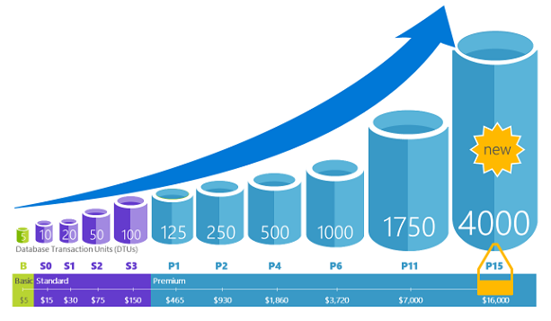
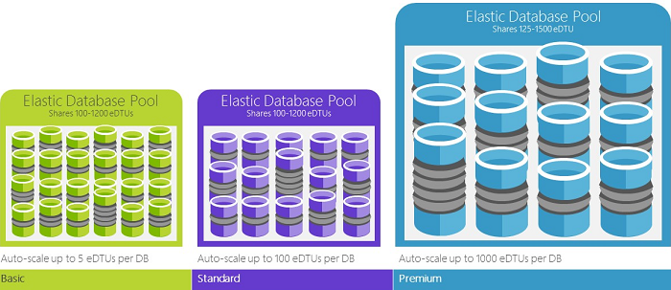
Azure SQL Database
PaaS Offering.
Database-as-a-Service
Relational database
Service tiers:
Basic
Standard
Premium
Premium RS
Elastic Pools.
Pooled databases delivers performance
Source: Microsoft

Slide 35
Azure SQL Database Transaction Unit
Processor - % Processor Time
Logical Disk - Disk Reads/sec
Logical Disk - Disk Writes/sec
Database - Log Bytes Flushed/sec
http://dtucalculator.azurewebsites.net/

Slide 36
Service Tiers
Basic
Small size
Low traffic
Single active operation
Standard
Low to medium IO performance requirements
Multiple current queries
Premium
High transaction volume
High IO performance requirements
Many concurrent users
High availability
For mission critical apps
Premium RS
IO-intensive apps
Does not require high availability
Analytical workloads

Slide 37
Service Tier Attributes
Service tier features | Basic | Standard | Premium | Premium RS
Maximum single database size | 2 GB | 250 GB | 4 TB* | 1 TB
Maximum elastic pool size | 156 GB | 4 TB | 4 TB* | 1 TB
Maximum database size in an elastic pool | 2 GB | 250 GB | 500 GB | 500 GB
Maximum number of databases per pool | 500 | 500 | 100 | 100
Maximum single database DTUs | 5 | 100 | 4000 | 1000
Maximum DTUs per database in an elastic pool | 5 | 3000 | 4000 | 1000
Database backup retention period | 7 days | 35 days | 35 days | 35 days
SKUs | Basic | S0-S12 | P1-P6, P11, P15 | PRS1, PRS2, PRS4, PRS6
https://docs.microsoft.com/en-us/azure/sql-database/sql-database-service-tiers

Slide 38
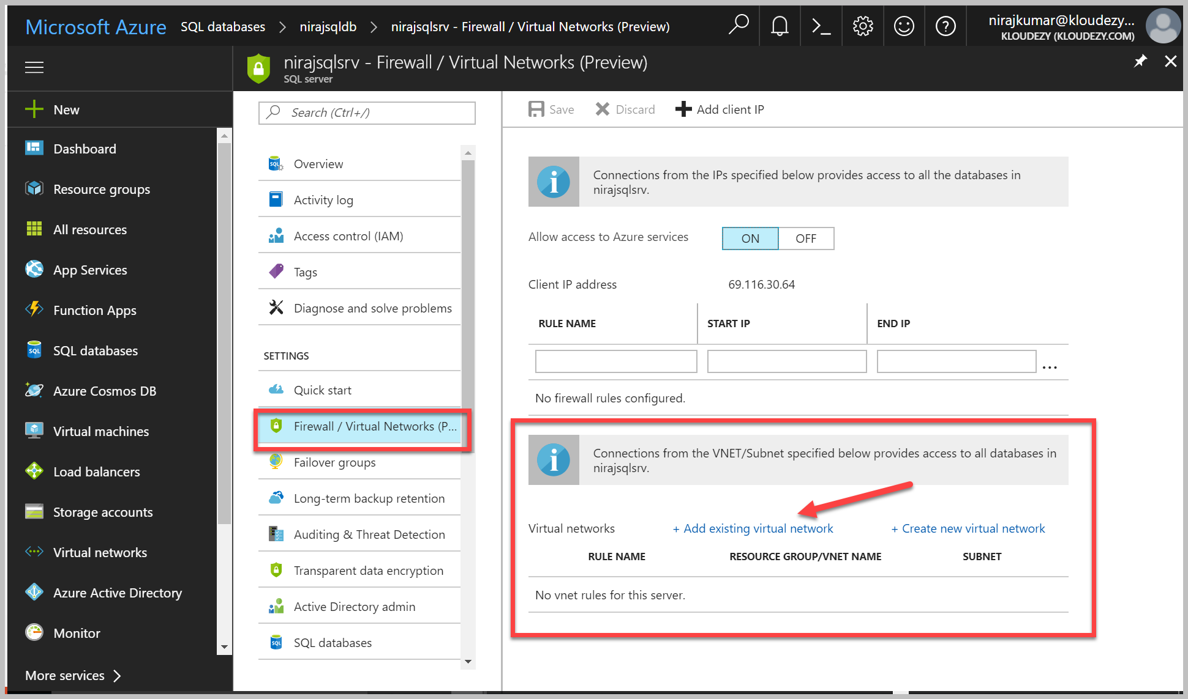
SQL Database Security
Firewall & Firewall Rules
Service Endpoints
Auditing for compliance and security
Encryption
TDE( Now supports BYOK, in public Preview)
Always Encrypt
Authentication: “Who are you?”
SQL Authentication
Azure Active Directory (AAD) Authentication (supports Federated identities and MFA)
Authorization
“What can you do?”
Dynamic data masking: Hide sensitive data from non-privileged users
Row-level security

Slide 39
Stretch Database architecture
How it works
Creates a secure linked server definition in the on-premises SQL Server
Targets remote endpoint with linked server definition
Provisions remote resources and begins to migrate eligible data, if migration is enabled
Queries against tables run against both local database and remote endpoint
Internet boundary
Local
database
Remote
endpoint
Local data
Linked servers
Remote data
Eligible data
On-premises instance
Azure
Notes:
Source: https://msdn.microsoft.com/en-us/library/mt169378(v=sql.130).aspx
Concepts and architecture for Stretch Database
Terms
Local database. The on-premises SQL Server 2016 database.
Remote endpoint. The location in Microsoft Azure that contains the database remote data. In SQL Server 2016, this is an Azure SQL Database server. This is subject to change in the future.
Local data. Data in a database with Stretch Database enabled that will not be moved to Azure based on the Stretch Database configuration of the tables in the database.
Eligible data. Data in a database with Stretch Database enabled that has not yet been moved, but will be moved to Azure based on the Stretch Database configuration of the tables in the database.
Remote data. Data in a database with Stretch Database enabled that has already been moved to Azure.
Architecture
Stretch Database uses the resources in Microsoft Azure to offload archival data storage and query processing.
When you enable Stretch Database on a database, it creates a secure linked server definition in the on-premises SQL Server. This linked server definition has the remote endpoint as the target. When you enable Stretch Database on a table in the database, it provisions remote resources and begins to migrate eligible data—if migration is enabled.
Queries against tables with Stretch Database automatically enabled to run against both the local database and the remote endpoint. Stretch Database uses the processing power in Azure to run queries against remote data by rewriting the query. You can see this rewriting as a “remote query” operator in the new query plan.

Slide 40
Exam Tip
Know:
Azure might update to change feature availability. The exam is updated over time, as well, to reflect these changes. However, because of the way Azure is steadily being updated, the newest features might not be on the exams.
Performance levels of the database are important to a company, and the ability to change this at times is equally important. For example, the limits of each level of SQL Database can help the architect to determine the minimum level needed to satisfy those needs.
https://docs.microsoft.com/en-us/azure/storage/storage-premium-storage#scalability-and-performance-targets

Slide 41
Azure SQL Glossary
Concepts you should have memorized and be able to compare and contrast variations on the exam
Transparent Data Encryption (TDE)
SQL Firewall
Database Transaction Unit(DTU)
Elastic DTU(eDTU)
Always Encrypt
Azure AD integrated Authentication
Failover Groups
Audit and threat detection
Active directory admin
Elastic pool
Geo Replication
Vulnerability Assessment
Data Sync
Dynamic data masking
Long term backup retention
Row Level Security

Slide 42
Azure Database for MySQL
A fully managed MySQL database service for app developers
Integrate the MySQL community edition with Azure for scalability, high availability, and your choice of languages and frameworks
Native MySQL that’s fully managed
Languages and frameworks of your choice
Built-in high availability
Scale within seconds
Simple and Flexible pricing
Unparalleled security and reach

Slide 43
Azure Database for PostgreSQL
Managed PostgreSQL database service for app developers
Integrate the PostgreSQL community edition with Azure for scalability, high-availability, and your choice of languages and frameworks.
Use native PostgreSQL that’s fully managed
Choose your languages and frameworks
Built-in high availability
Scale within seconds
Simple and Flexible pricing
Unparalleled security and reach

Slide 44




Azure Cosmos DB A globally distributed, massively scalable, multi-model database service
MongoDB
Table
Column-family
Document
Key-value
Graph
Elastic scale out
of storage & throughput
Guaranteed low latency at the 99th percentile
Five well-defined consistency models
Turnkey global distribution
Comprehensive SLAs
Notes:
Azure Cosmos DB offers the first globally distributed, multi-model database service for building planet scale apps. It’s been powering Microsoft’s internet-scale services for years, and now it’s ready to launch yours.
Only Azure Cosmos DB makes global distribution turn-key.
You can add Azure locations to your database anywhere across the world, at any time, with a single click. Cosmos DB will seamlessly replicate your data and make it highly available.
Cosmos DB allows you to scale throughout and storage elastically, and globally! You only pay for the throughput and storage you need – anywhere in the world, at any time.

Slide 45
Azure Cosmos DB
SQL API
A schema-less JSON database engine with rich SQL querying capabilities
MongoDB API
A massively scalable MongoDB-as-a-Service compatible with existing MongoDB libraries, drivers, tools and apps.
Cassandra API
A globally distributed Cassandra-as-a-Service compatible with existing Apache Cassandra libraries, drivers, tools and applications
Graph(Gremlin) API
A fully managed, horizontally scalable graph database service tht supports Open Graph APIs based on apache TinkerPop and Gremlin
Table API
A key-value database service built to provide premium capabilities

Slide 46
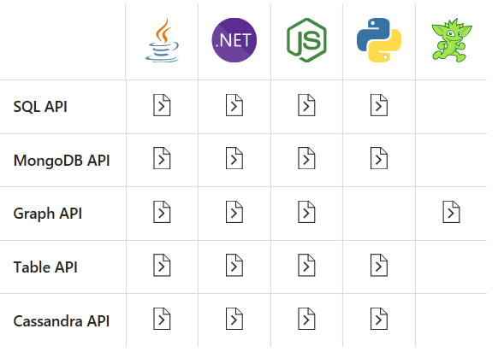
Azure CosmosDB Application Integration

Slide 47
Cosmos DB
Azure Cosmos DB is a globally distributed database service
“one of the supported APIs and data models”
Document != *.docx
Document == JSON
NoSQL, Schema free database
99.99% availability within a single region.
It is a good choice for new web, mobile, gaming, and IoT applications
HIPAA-compliant
PaaS

Slide 48
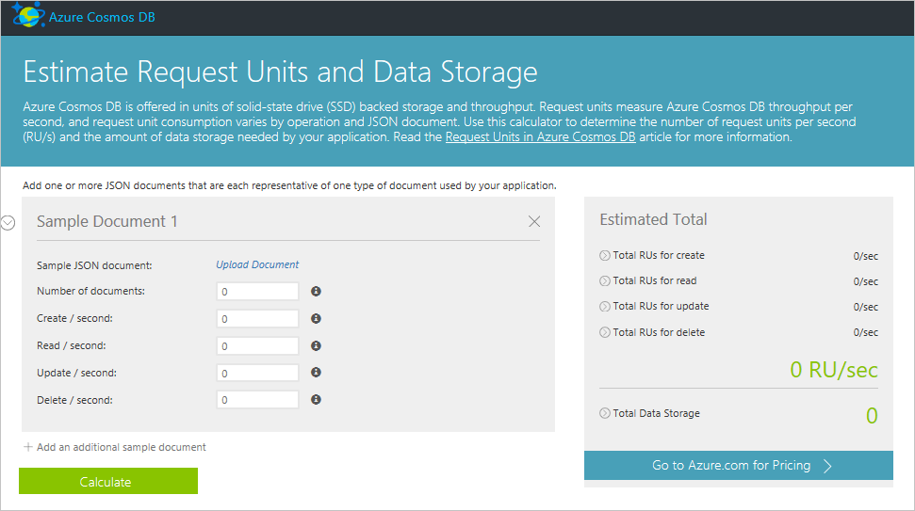
Scaling / Costing based on Request Units
https://docs.microsoft.com/en-us/azure/cosmos-db/request-units

Slide 49
Azure CosmosDb KeyWords
Concepts you should have memorized and be able to compare and contrast variations on the exam
Indexing Policy
Partition Key
Row Key
Request Unit(RU)
Key-Value Pair
No SQL
Schema less
Atoms, Records and Sequences(ARS)
Master Key
Preferred Locations
Collection
Connection String
Notes:
Indexing Policy
How can I override the properties to include or exclude from indexing?
How can I configure the index for eventual updates?
How can I configure indexing to perform ORDER BY or range queries?
How do I make changes to a collection’s indexing policy?
How do I compare storage and performance of different indexing policies?
https://azure.microsoft.com/en-gb/blog/a-technical-overview-of-azure-cosmos-db/
Atoms consist of a small set of primitive types e.g. string, bool, number etc., records are structs and sequences are arrays consisting of atoms, records or sequences.
Key type Resources Master keys Used for administrative resources: database accounts, databases, users, and permissions Resource tokens Used for application resources: containers, documents, attachments, stored procedures, triggers, and UDFs

Slide 50
Q&A

Slide 51
Resources

Slide 52
Practice Exercises
Blob Labs for .NET
https://azure.microsoft.com/en-us/resources/samples/storage-blob-dotnet-getting-started/
https://github.com/Azure-Samples/storage-blob-dotnet-getting-started
Table Labs for .NET https://github.com/Azure-Samples/storage-table-dotnet-getting-started Azure Storage Samples https://azure.microsoft.com/en-us/resources/samples/?service=storage
SAS Labs
https://azure.microsoft.com/en-us/resources/samples/storage-dotnet-sas-getting-started/

Slide 53
Azure SQL Database References
SQL Database Videos
https://azure.microsoft.com/en-us/resources/videos/index/?services=sql-database

Slide 54
CosmosDB References
A technical overview of Cosmos DB
Global distribution with Azure Cosmos DB.
Automatic regional failover for business continuity in Azure Cosmos DB
How to partition and scale in Azure Cosmos DB
Tunable data consistency levels in Azure Cosmos DB
Performance and scale testing with Azure Cosmos DB
Schema-agnostic indexing in Cosmos DB (VLDB paper on how we do indexing in Cosmos DB)
How does Azure Cosmos DB index data
Request Units in Azure Cosmos DB
Expire data in Azure Cosmos DB collections automatically with time to live
Automatic online backup and restore with Azure Cosmos DB
Integration of Cosmos DB with Spark
Azure Cosmos DB SLA

Slide 55
DocumentDB Resources
Stored Proc Programming Video
https://docs.microsoft.com/en-us/azure/cosmos-db/programming
DocumentDB vs MongoDB
https://medium.com/@th0maswe1ss/azure-documentdb-vs-mongodb-6d5806c16239
Getting Started
https://docs.microsoft.com/en-us/azure/cosmos-db/documentdb-get-started

Slide 56
DocumentDB Programming Options
Server-side programming options
Stored procs, triggers, & user-defined functions
Written in JavaScript
https://docs.microsoft.com/en-us/azure/cosmos-db/programming

